Slide 1
May Generative AI Be a Reviewer on an Academic Paper?
Dr. Haichen Zhou
iConference 2024

Slide 2
Generative AI
Definiton: Generative AI (GenAI) is a novel technology that uses artificial intelligence to generate content in various forms.
Text Image Video Audio

Slide 3
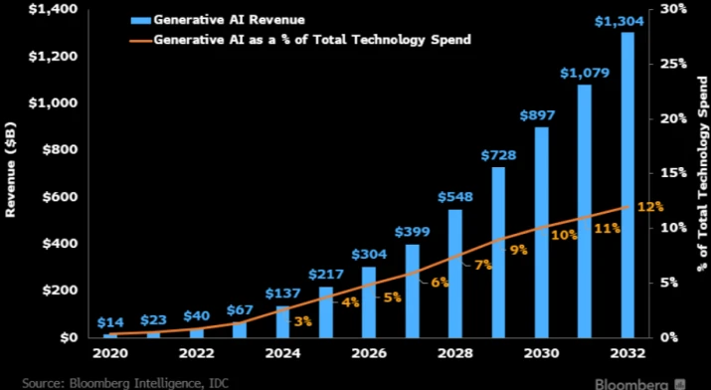
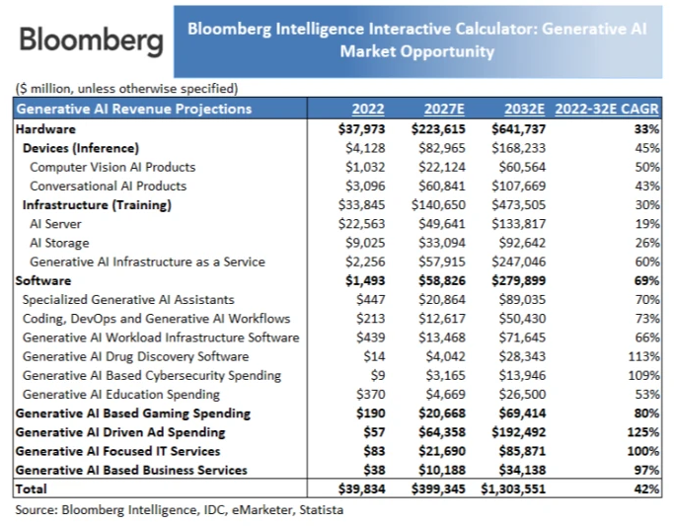
Generative AI
Bloomberg Intelligence: GenAI market is expected to explode in next 10 years.
GenAI Revenue GenAI Market Opportunity

Slide 4
Research Questions
GenAI seems promising for automative academic evaluations.
May Generative AI Be a Reviewer on an Academic Paper?
RQ1: Can GenAI conduct academic evaluations?
RQ2: What differences exist between the scoring results of
GenAI and human experts?
RQ3: What differences exist between the evaluation text
features of GenAI and human experts?

Slide 5
Research Method
VS
Expert Evaluation Scores
GenAI Evaluation Scores
Expert Evalution Texts
GenAI Evalution Texts

Slide 6
Research Method
1. Obtain paper and evaluation data. 2. Design evaluation criteria and scoring system.
3. Generate the question template. 4. Collect GenAI data 5. Compare the differences between experts and GenAI.

Slide 7
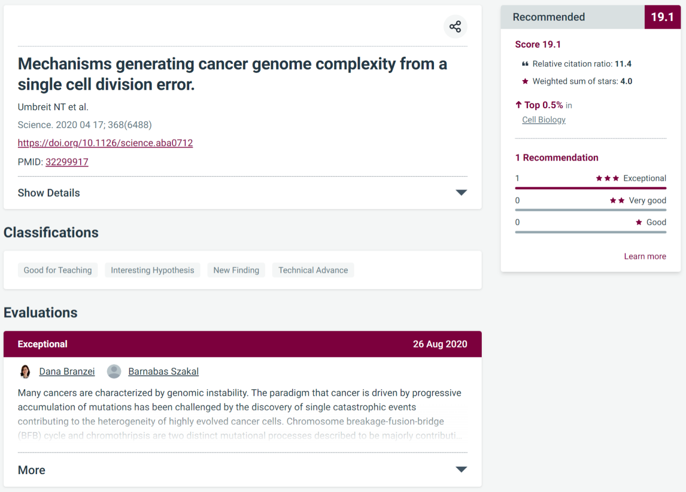
Data Source
Expert Evaluation Score
Expert Evalution Texts

Slide 8
Paper Selection
Table 1 Example of the post-collection data
1.Research field ： Cell Biology
2.Publish year：2020
3.Number of evaluation：1
Fields | Context
Title | Mechanisms generating cancer genome complexity from a single cell division error.
DOI | 10.1126/science.aba0712
Pubmed ID | 32299917
Recommendations | 3 Stars(Exceptional)
Evaluation Text | Many cancers are characterized by genomic instability. The paradigm that cancer is driven by progressive accumulation of mutations has been challenged by the discovery of single catastrophic events contributing to the heterogeneity of highly evolved cancer cells...
853 papers

Slide 9
Question Template Design
We summarized the review principles of top journals in Cell Biology.

Slide 10
Question Template Design
Table 2 Evaluation dimensions of Cell Biology
Dimensions | Definitions
Originality | The paper must report novel, innovative and influential research that does not repeat or plagiarize existing work.
Accuracy | The paper must follow high standards of experimental design, data analysis and result presentation, without errors, biases or misleading.
Conceptual advance | The paper must provide a deep understanding and mechanistic explanation of an important problem or area, not just superficial or incremental improvements.
Timeliness | The paper must reflect the current hot topics in the scientific community.
Significance | The paper must have immediate or long-term impact and implications.

Slide 11
Question Template Design
Prompt
I have summarized a set of criteria for evaluating academic papers: •Originality: ... •Accuracy: ... •Conceptual advance: ... •Timeliness: ... •Significance: ... I also have a recommended scoring system: 1 star (Good) , 2 stars (Very Good) , 3 stars (Exceptional) .You're acting as a scientist. I'll give you a PubMed ID for the paper. First, Please display the title of the paper and search the web site. No abstract is required. Second, please according to my criteria and scoring system for evaluation and scoring the paper; Third, please according to my scoring system for the overall evaluation and scoring of the paper. Pubmed ID:XXXXXXXX

Slide 12
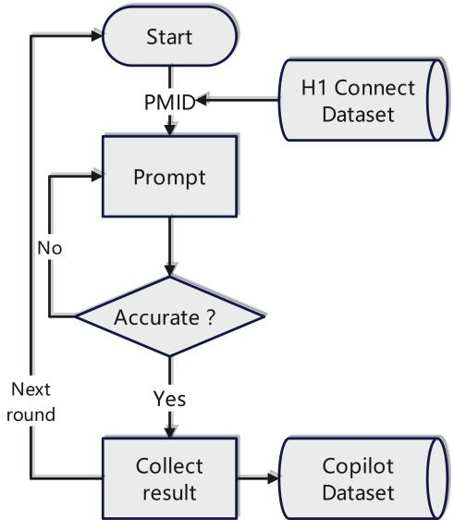
Collecting Copilot Evaluation Results
Figure 1: Flow chart of collecting Copilot evaluation results.

Slide 13
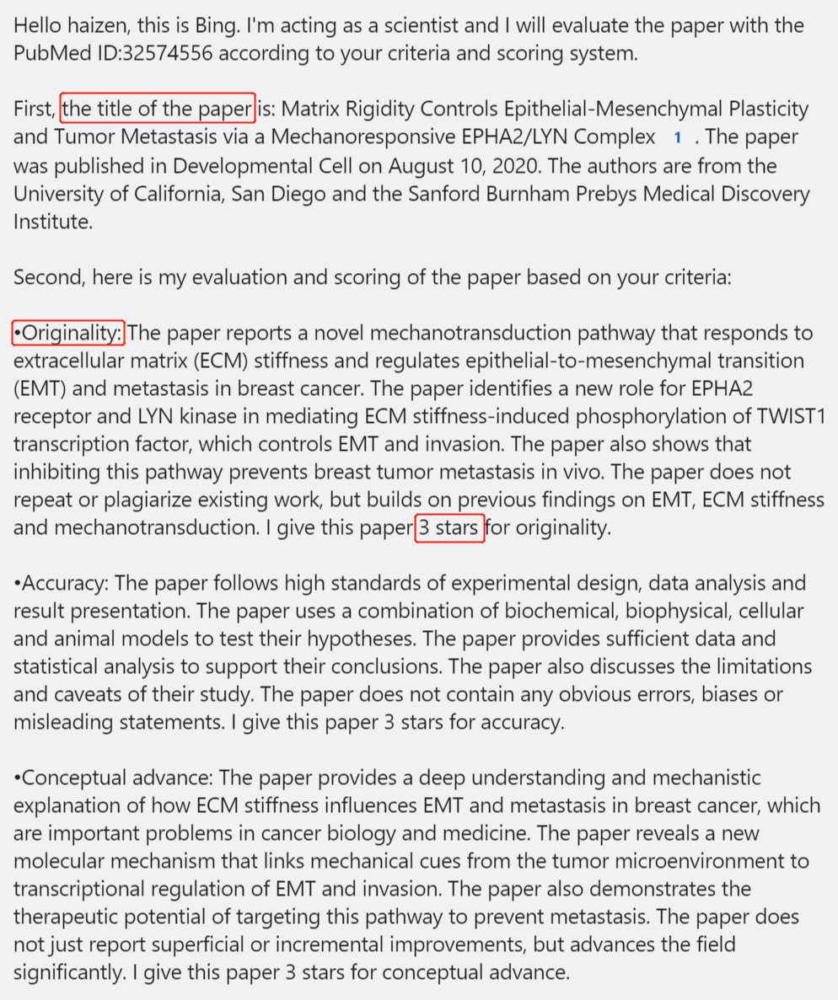
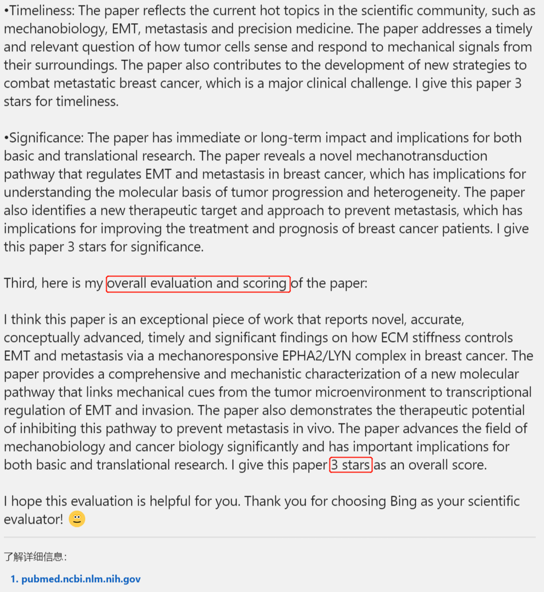
Result and Discussion
RQ1: Can GenAI conduct academic evaluations? GenAI can conduct academic evaluations and produce readable results in form.

Slide 14
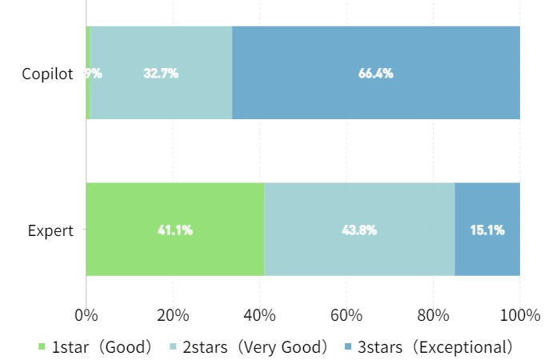
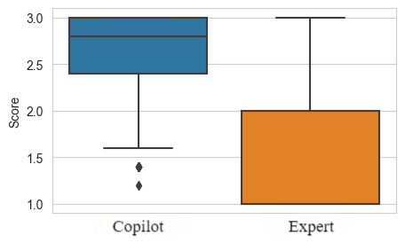
Result and Discussion
RQ2: What differences exist between the scoring results of GenAI and human experts?
Figure 2: Scoring ratio between Copilot and expert.
Figure 3: Scoring box plot between Copilot and expert.

Slide 15
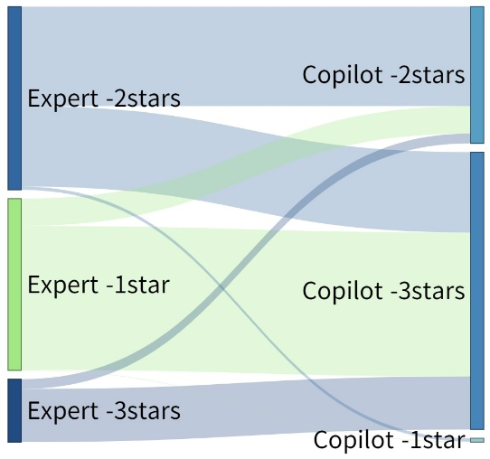
Result and Discussion
Figure 4: The source of score differences between Copilot and expert.

Slide 16
Result and Discussion
RQ3: What differences exist between the evaluation text features of GenAI and human experts?
Figure 5: The number of sentences and the average sentence length between Copilot and expert.

Slide 17
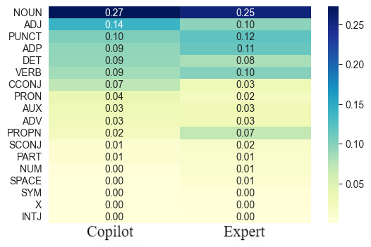
Result and Discussion
RQ3: What differences exist between the evaluation text features of GenAI and human experts?
Table 1 Word counts between Copilot and expert
Word (Copilot) | Counts | Word (Expert) | Counts
paper | 2539 | cell | 1091
research | 749 | protein | 697
novel | 677 | study | 481
report | 560 | author | 436
provide | 461 | cancer | 309
high | 444 | bind | 295
field | 421 | gene | 285
implication | 394 | expression | 244
cell | 354 | increase | 243
significant | 335 | role | 240
Figure 6: The proportion of word types between Copilot and expert.

Slide 18
Conclusion
Copilot can score and evaluate under specific prompts.
There is a significant difference in the scoring patterns between Copilot and experts: the former tends to give higher star, but the high proportion of 3-star reveals that it does not have enough ability to judge the actual value of the paper.
Copilot’s shorter sentences and generic wording indicate that its evaluation is only at the stage of imitating the features of the evaluation text, and it cannot yet carry out substantive evaluations of the originality, accuracy, and other core elements of the paper.

